Slide 1
Multiplexer
MUX

Slide 2
Multiplexer
Multiplexer (Selector)
2^{n} data inputs,
n control inputs,
1 output
Used to connect 2^{n} points to a single point
Form binary index of input connected to output
A
Z
0
I
I
1
I
0
0
2:1
Z
1
I
1
mux
A
I
0
I
1
4:1
Z
I
2
mux
I
3
A
B
I
0
I
1
I
2
I
3
8:1
I
4
mux
Z
I
5
I
6
I
7
A
B
C

Slide 3
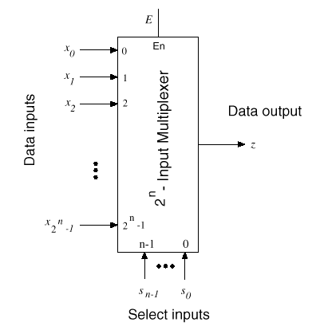
Multiplexer
…
…

Slide 4
Boolean Functions
I
0
2:1
A
I₀
A
I
mux
Z
00
01
11
10
1
I₁
0
0
1
0
0
A
1
0
1
1
1
I
0
I
1
4:1
I
Z
I₀
2
mux
I
3
A
B
I
0
I
1
I
2
I
3
8:1
I
4
mux
Z
I
5
I
6
I
7
A
B
C

Slide 5
Boolean Functions
I
0
2:1
A
I₀
A
I
mux
Z
00
01
11
10
1
Z = A' I₀ + A I₁
I₁
0
0
1
0
0
A
1
0
1
1
1
I
0
I
1
4:1
I
Z
I₀
2
mux
I
3
A
B
Z = A' B' I₀ + A' B I₁ + A B' I₂ + A B I₃
I
0
I
1
I
2
Z = A' B' C' I₀ + A' B' C I₁ + A' B C' I₂ + A' B C I₃ +
A B' C' I₄ + A B' C I₅ + A B C' I₆ + A B C I₇
I
3
8:1
I
4
mux
Z
I
5
2^{n} -1
I
6
In general, Z = Σ m_{k} I_{k}
I
7
k=0
A
B
C
in minterm shorthand form

Slide 6
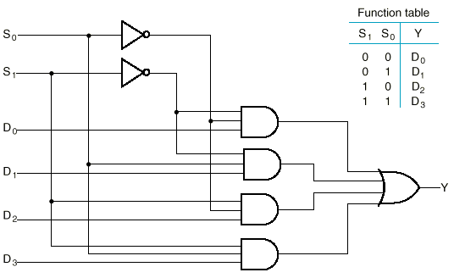
Circuit Diagram
A | B | Y
0 | 0 | I₀
0 | 1 | I₁
1 | 0 | I₂
1 | 1 | I₃
4-to-1 MUX
A
B
I₀
I₁
I₂
I₃

Slide 7
Cascading MUXes
Design a MUX (8:1) by smaller MUXes
I
0
I
1
I
2
I
3
Z
I
4
I
5
I
6
I
7
B
C
A

Slide 8
Cascading MUXes
Design a MUX (8:1) by smaller MUXes
I
0
0
I
4:1
1
1
mux
I
2
2
I
3
S
S
0
2:1
Z
3
1
0
mux
I
4
0
1
S
I
4:1
5
1
mux
I
6
2
I
7
3
S
S
1
0
B
C
A

Slide 9
Another Implementation

Slide 10
Larger Data Lines
What if we want to select m-bit data/words?
→ Combine MUX blocks in parallel with common select and enable signals

Slide 11
4-bit data
Example:
Selection between 2 sets of 4-bit inputs
Enable line turns MUX on and off (E=1 is on).
x₀
x₁
x₂
z₀
x₃
z₁
z₂
y₀
z₃
y₁
y₂
y₃
A

Slide 12
4-bit data
Example:
Selection between 2 sets of 4-bit inputs
x₀
x₁
x₂
z₀
x₃
z₁
z₂
y₀
z₃
y₁
y₂
y₃
A

Slide 13
4-bit data
Example:
Selection between 2 sets of 4-bit inputs
I
0
2:1
I
mux
Z
1
x₀
A
x₁
I
0
2:1
x₂
I
mux
Z
1
z₀
?
x₃
z₁
A
I
z₂
y₀
0
2:1
I
mux
Z
z₃
y₁
1
y₂
A
I
0
2:1
y₃
Z
I
1
mux
A

Slide 14
Application
A
B
C
D
Multiple input sources:
A+C
A+D
B+C
B+D
Sa
MUX
MUX
Sb
X
Y
Sum

Slide 15
MUX by 3-State Buffers
Three-state logic in place of AND-OR
S
0
I
0
I
1
S
1
Y
I
2
I
3
(b)
Output of gates can be connected

Slide 16
General Logic by MUX
Any Boolean function of n variables can be implemented using a 2^{n-1}-to-1 multiplexer.

Slide 17
General Logic by MUX
Example:
F = A' B' C' + A' B C' + A B C' + A B C
0
A
B
C
F
1
0
0
0
1
2
F
0
0
1
0
3
8:1
0
1
0
1
4
MUX
0
1
1
0
5
1
0
0
0
6
7
S2 S1 S0
1
0
1
0
1
1
0
1
1
1
1
1

Slide 18
General Logic by MUX
Example:
F = A' B' C' + A' B C' + A B C' + A B C
0
A
B
C
F
1
0
0
0
1
2
F
0
0
1
0
3
8:1
0
1
0
1
4
MUX
0
1
1
0
5
1
0
0
0
6
7
S2 S1 S0
1
0
1
0
1
1
0
1
1
1
1
1

Slide 19
General Logic by MUX
Example:
F = A' B' C' + A' B C' + A B C' + A B C
= A' B' (C') + A' B (C') + A B' (0) + A B (1)
1
0
A
B
C
F
A
B
F
0
1
0
0
0
1
C’
0
0
C’
1
2
F
0
0
1
0
0
1
C’
0
3
8:1
0
1
0
1
1
0
0
0
4
MUX
0
1
1
0
C’
0
5
1
1
1
1
6
1
0
0
0
0
1
7
S2 S1 S0
1
0
1
0
1
1
0
1
1
A
B
C
1
1
1
1

Slide 20
Using Smaller MUX
How about implementing a 4-variable function by a 4:1 MUX
Can still be done
2 input variables go to the 2 control lines directly
The other 2 input variables will go to the MUX inputs using some necessary gates
Choose the 2 that go to control inputs and the 2 that go to the MUX inputs carefully!
The choice affects the number of necessary gates

Slide 21
General Logic
By decoder:
Multiple outputs:
A single decoder,
One OR for each output
By MUX:
Multiple outputs:
One MUX for each output,
No need for OR
→ Use MUX for few outputs,
→ Use decoder for many outputs.

Slide 22
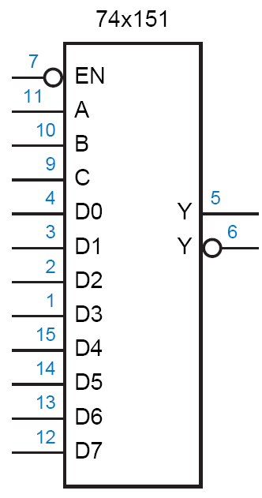
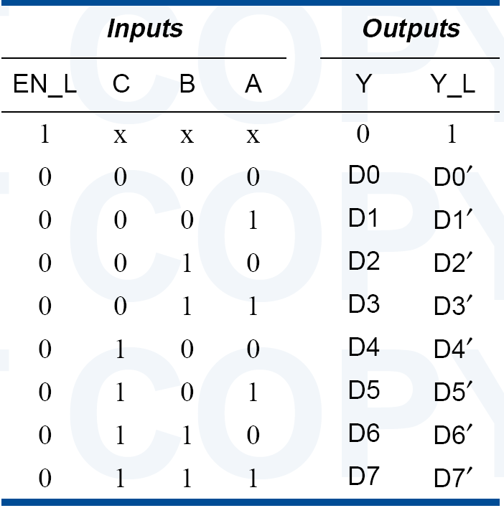
Standard MSI MUXes
74x151
8:1 MUX

Slide 23
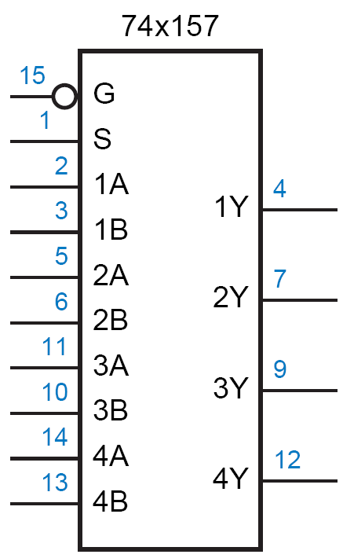
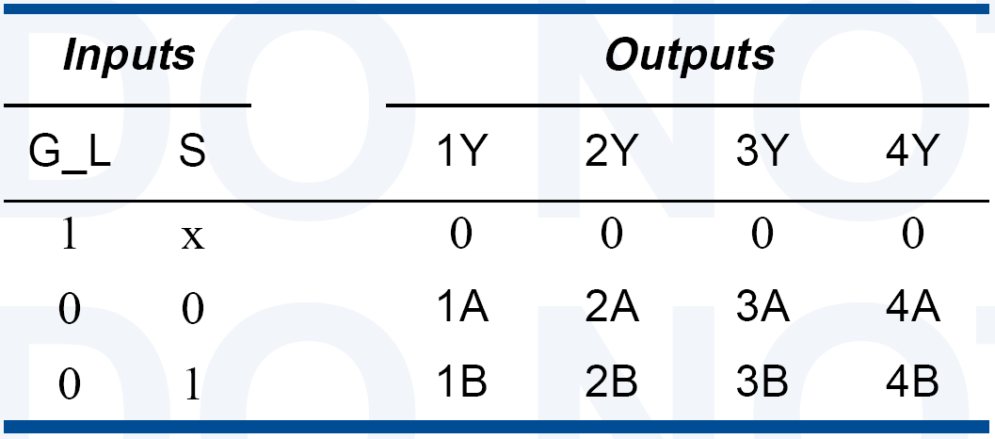
Standard MSI MUXes
74x157
2:1 4-bit MUX

Slide 24
Demultiplexer
DEMUX

Slide 25
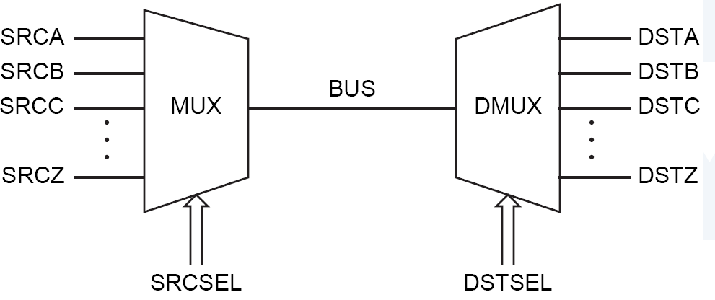
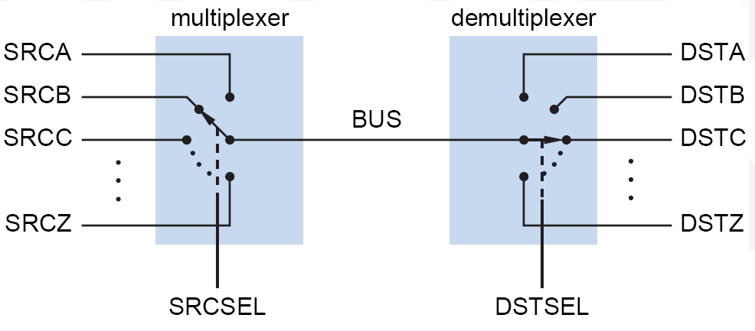
DEMUX

Slide 26
DEMUX

Slide 27
Decoder vs. Demux
E | A | B | C | O₀ | O₁ | O₂ | O₃ | O₄ | O₅ | O₆ | O₇
0 | X | X | X | 0 | 0 | 0 | 0 | 0 | 0 | 0 | 0
1 | 0 | 0 | 0 | 1 | 0 | 0 | 0 | 0 | 0 | 0 | 0
1 | 0 | 0 | 1 | 0 | 1 | 0 | 0 | 0 | 0 | 0 | 0
1 | 0 | 1 | 0 | 0 | 0 | 1 | 0 | 0 | 0 | 0 | 0
1 | 0 | 1 | 1 | 0 | 0 | 0 | 1 | 0 | 0 | 0 | 0
1 | 1 | 0 | 0 | 0 | 0 | 0 | 0 | 1 | 0 | 0 | 0
1 | 1 | 0 | 1 | 0 | 0 | 0 | 0 | 0 | 1 | 0 | 0
1 | 1 | 1 | 0 | 0 | 0 | 0 | 0 | 0 | 0 | 1 | 0
1 | 1 | 1 | 1 | 0 | 0 | 0 | 0 | 0 | 0 | 0 | 1
O₀
ABC
A
S₂
O₁
ABC
O₂
ABC
B
S₁
3:8
O₃
ABC
C
dec
O₄
ABC
S₀
O₅
ABC
O₆
ABC
O₇
ABC
Enb

Slide 28
Decoder vs. Demux
O₀
ABC
A
S₂
O₁
ABC
O₂
ABC
B
S₁
3:8
O₃
ABC
C
dec
O₄
ABC
S₀
O₅
ABC
O₆
ABC
O₇
ABC
Enb

